Slide 1

SUPERSTORE SALES ANALYSIS
PREPARED BY :
OSALOBO EGHOSA
DATA ANALYST

Slide 2
Dataset Overview
Dataset Name: Superstore Sales Dataset
Dataset Size: 9,995 Rows and 21 Columns
Key Data Fields:
• Order Date
• Ship Date
• Customer Name
• Region
• Category
• Sub-Category
• Sales
• Quantity
• Discount
• Profit
Data Preparation Performed:
• Cleaned column names
• Checked missing values
• Verified data types
• Formatted date columns
• Validated numeric measures
• Created Date Table for time intelligence
Tools Used:
• Microsoft Power BI
• Power Query Editor
• DAX (Data Analysis Expressions)

Slide 3
Business Problem
Business Problem Key Questions Addressed
Statement 1. Which region generates the most profit?
The business needed a way to: 2. Which category performs best?
Identify underperforming products 3. Which products are underperforming?
Monitor sales and profit performance 4. How do discounts affect profit?
Analyze regional sales trends 5. What are the yearly sales trends?
Understand the impact of discounts
on profitability
Track down business growth over time.
Goal: Create an interactive dashboard that supports data-driven decision-making for business stakeholders and non-technical stakeholders.

Slide 4
Key Performance Indicators
Dashboard KPIs
Total Revenue: $2.3M
Total Profit: $286.40K
Total Orders: 5,009
Profit Margin: 12.47%
Total Quantity Sold: 37.87K
Average Discount: 15.62%
DAX Measures Used
SUM()
DISTINCTCOUNT()
AVERAGE()
DIVIDE()
DATEADD()
Purpose Of KPIs
Measure business performance
Monitor Sales growth
Track profitability
Evaluate operational efficiency

Slide 5
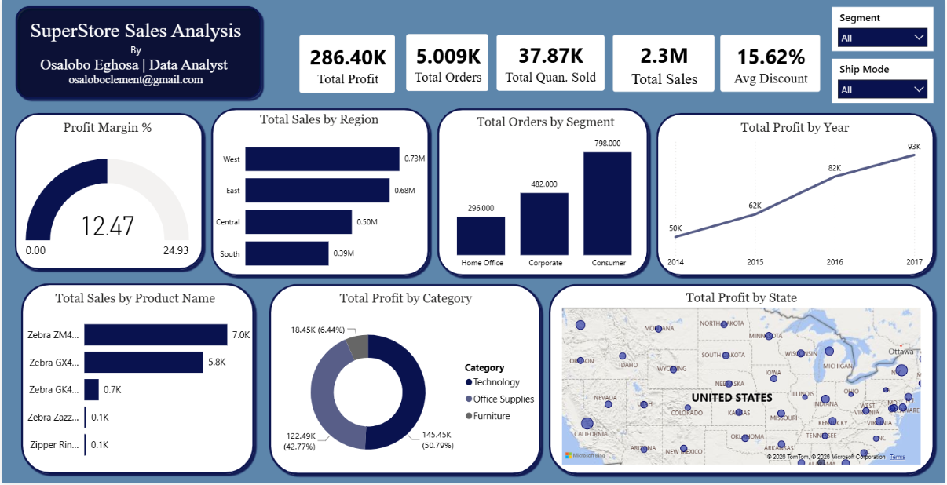
DASHBOARD

Slide 6
Key Business Insights
Sales & Profitability
The west region generated the highest sales and profit
The south region generated the lowest sales performance
Technology was the best performing category
Some furniture products generated low or negative profit
Sales increased significantly from 2015- 2017, showing business growth
Discount Impact
Several products recorded losses despite strong sales volume
Higher discounts reduced profit margins significantly
Geographic Insights
California and New York contributed significantly to overall sales
Some states had strong sales but weak profitability

Slide 7
Strategic Business Recommendation
Profitability Improvement & Product Strategy
Reduce excessive discounting among low-margin products
Review pricing strategies for understanding categories
Focus more on high-performing Technology products
Re-evaluate poorly performing products sub-categories
Regional Growth
Develop targeted strategies for low-performing states
Invest more resources in high-performing regions like the West

Slide 8
Challenges Encountered During The Project
Data Challenge
Discount column contained many zero values
Profit column included negative values
Data cleaning and validation were required
Technical Challenge
Building DAX measures for time intelligence
Designing an organized dashboard wireframe
Configuring map visualizations correctly
Ensuring visuals interacted properly with slicers
Dashboard Design Challenge
Selecting appropriate visualizations
Maintaining readability and consistency
Balancing dashboard aesthetics with functionality

Slide 9
Conclusion
This Project successfully transformed raw Superstore sales data into a professional interractive dashboard using Microsoft Power BI
Project Achievement
Built interactive visual reports
Developed meaningful KPIs
Identified business performance trends
Improved understanding of regional product profitability
Demonstrated practical business intelligence skills
Skills Demonstrated
Data Cleaning
Data Visualization
Business Intelligence(BI)
DAX Calculations
KPI Reporting
Analytical Thinking
Overall Conclusion
This analysis provides stakeholders with clear and interactive way to monitor business performance and make data-driven decisions effectively.

